Slide 1
Time2Go Augmented Reality App
Final Presentation

Slide 2
Project Overview
Project Goals and Objectives
Team Members Contributions
Project Future plans/ Opportunities

Slide 3
Marekt Research
The global online travel market size was valued at $354.2 billion in 2020 and is estimated to reach $1,835.6 billion by 2031.
online travel market trends, on the basis of service types, the travel accommodation segment was the considerable contributor to the market, with $123.7 billion in 2020, and is estimated to reach $719.5 billion by 2031

Slide 4
Project Quality
Quality Management
Identifying project and product quality requirement
Measure Project quality
Quality assurance

Slide 5
Verification/ Validation Process
Check-up
Process
Scrutiny
Unit Testing
Integration Testing
System Testing

Slide 6
Communication Management Plan
Stakeholder Communication Requirements:
User-friendly UI (User Interface)
Accessibility Requirements
Information Organization
User Feedback
To provide updates and status reports, communication methods have been established with the stakeholders. Communication will happen regularly, in the form of in-person meetings, as well as via e-mail.
Guidelines: The meetings should be conducted in a professional and time-bound manner. All the details regarding a meeting should be documented clearly and unambiguously for later review.
Resolving issues should be resolved at the lowest level possible. When they cannot be resolved, affected parties should alert their immediate supervisors of the issues. If an issue becomes critical to the project or becomes time-sensitive, the issue should be brought directly to the project manager via Email or Phone.

Slide 7
Risk Register
Fail to establish collaboration with potential participants
Fail to finish the online platform onetime
Unexpected injury of team members
Participants surplus
Sponsor withdrawal
Inadequate budget estimates
Cost Risk
External Hazard Risk
Third-party dependencies may affect deadlines
Team members alter tasks without approval

Slide 8
Probability/Impact Matrix
Risk 7
high
Probability
Risk 1
Risk 8
Risk 9
Risk 2
Risk 6
medium
Risk 3
Risk 4
Risk 5
Risk 10
low
low
medium
high
Impact

Slide 9
This requirements management plan will define the process of gathering and documenting the Requirements for the time2go project including creating a platform for various agencies to access and complete the grant application online. This document will also establish what the process will be regarding gathering changes to the time2go project and how the changes will be documented, listed, and controlled. Scope Time2go Travel app will provide secure, simplified, and paperless process payments methods Time2go application will provide customers joyful and easy user experience Time2go online website will be able to advise applicants of the application status once the application has been completed.
Requirements Management Plan

Slide 10
Prioritizing Requirements:
The attributes of prioritizing and tracking requirements for the time2go project will be as follows:
Status: Approved, not approved, pending approval
Impact: High, Medium, Low
Criticality: High 7-10, Med 4-6, Low 1-3
Stability: Volatile, Neutral, Unlikely to Change
Efforts: Points 1(2Hrs or less), 2(2-4hrs), 4(4-8Hrs), and so on.
Roles and Responsibilities:
Naazim – Project Manager
Pritesh Bharadiya – Software Engineer Lead
Aswini Chacko – Technical Project Manager
Suriya Arivanandhan – Testing team Lead

Slide 11
Weighted Average Scoring Model
Criteria | Weight | P1 | P2 | P3 | P4
Uniqueness | 20% | 92 | 80 | 50 | 50
Cost effective | 10% | 90 | 63 | 75 | 40
Ease of development | 10% | 84 | 56 | 76 | 45
Scope | 20% | 80 | 80 | 42 | 60
Technology | 25% | 87 | 70 | 75 | 60
Time | 15% | 75 | 45 | 57 | 46
Weighted score | 100% | 84.8 | 68.15 | 60.8 | 52.4
P1 - Design a virtual travel app by metaverse and accept the payments for bookings on the app using cryptocurrency.
P2 - An app to facilitate acceptance of cryptocurrency from the customers and paying the ecommerce platform through cash on behalf of customer.
P3 - Include feature of sending notification of price hike in crypto currency wallet.
P4 - App that has a map for locating stores that accepts crypto currency.

Slide 12
Business Case
Objective: Travel affordable for everyone
Problem statement: Expensive travel packages, travel restrictions
Option Analysis: Perforce Vs Metaverse
Constraints: Emerging technology, lack of experience
Budget: $3,37,600
Schedule: 83 Days
Risks: Dependency, overbudget, privacy, delay.
$3,37,600
Budget
$516,500
Annual revenue
28,362
Total app downloads

Slide 13
WBS
Initiation
Identify Project leader
Identify Team matrix
Develop project charter
Create Project scope
Develop stakeholder register
Planning
Define requirements
Develop schedule
Estimate budget
Business case
Create WBS
Identify tasks and process flow
Task duration
Assign resource to task
Risk identification
Formal approval of the Project plan
Conduct kick-off meeting
Execute
Create Content
Create template
User Interface designing
Create travel app in metaverse
Product deliverables
Feedback
Test application
Monitor & Control
Analyze and Evaluation of travel app
Modifications if any
Approve or reject the changes
Closing
Lessons learnt session
Project close
Build phase testing
Testing and reviewing
Record the result

Slide 14
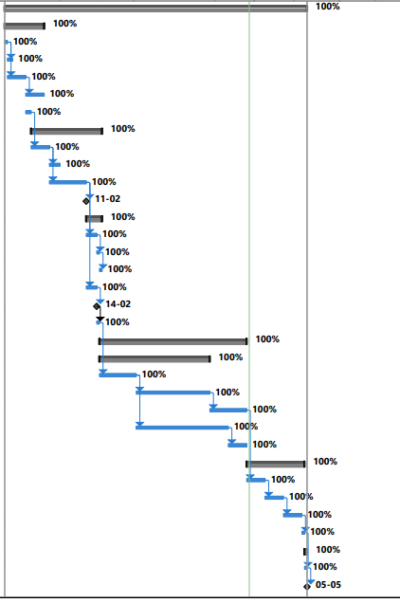
Gantt Chart
Task Name | Duration
Travel App using metaverse | 83 days
Initiation | 11 days
Planning | 19 days
Execute | 40 days
Monitor & Control | 16 days
Test application | 1 week
Closing | 1 day

Slide 15
Security Management Plan
Categorizing the security challenges
All the security threats should be assessed and controls defined
Fake identities: It can be tackled by Multi Factor Authentication. Password and passcode sent for authentication is chosen as MFA.
Discord channels: This attack can be avoided by improving message scanning settings.
Phishing attacks: In metaverse it could be an avatar of a teller in a virtual bank lobby asking for your information. Users has to be cautious about this.
Security related system alerts and failures
Documenting incidents
Assessing the risk
Validity check periodically

Slide 16
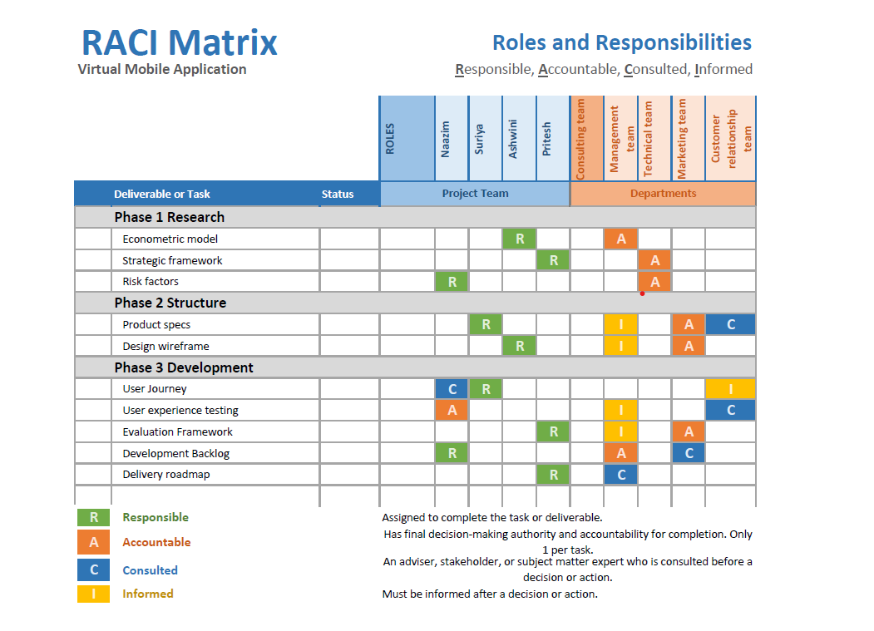

Slide 17
Milestones
Project Initiation
Business case
Formal approval of the Project plan
Project Approval
Project Closure

Slide 18
Change Request Methodology
Legal Name Change - legal agreements are changed to META
Covid Risks - space for product launch and gives huge scope for market success.
Metaverse Development - to develop a own metaverse platform to create a virtual reality for places inside mobile application.
Data privacy and security - to create strong passwords/PIN, regular cookies clearance policy and two/multi-factor authentication using authenticators to enter the mobile application.

Slide 19
Team Charter
Code of Conduct
Participation
Communication
Problem Solving
Meeting Guidelines

Slide 20
Thank You!

